Slide 1

Extracting Tweet Entities

Slide 2
What is ENTITY EXTRACTION?
It is a process where an algorithm takes a string of text as input and identifies relevant nouns (people, places and organizations) that are mentioned in that string.

Slide 3
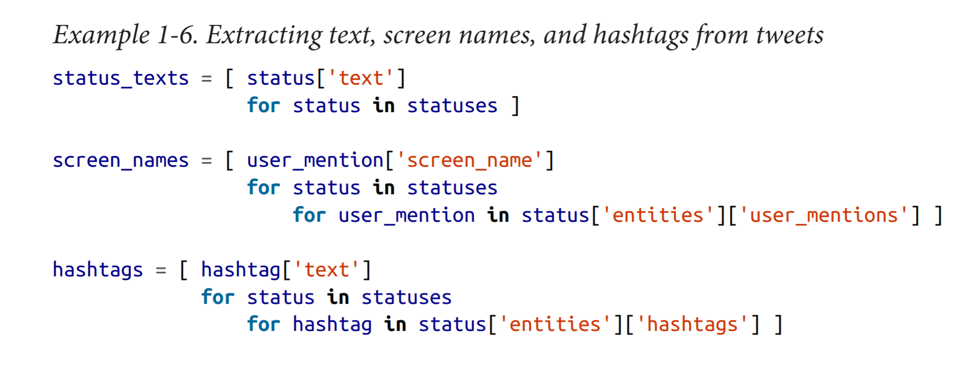
Below example extracts the text, screen names, and hashtags from the tweets that are collected and introduces a Python idiom called a double (or nested) list comprehension.

Slide 4
If you understand a (single) list comprehension, the code formatting should illustrate the double list comprehension as simply a collection of values that are derived from a nested loop as opposed to the results of a single loop.
List comprehensions are particularly powerful because they usually yield substantial performance gains over nested lists and provide an intuitive (once you’re familiar with them) yet terse syntax.

Slide 5
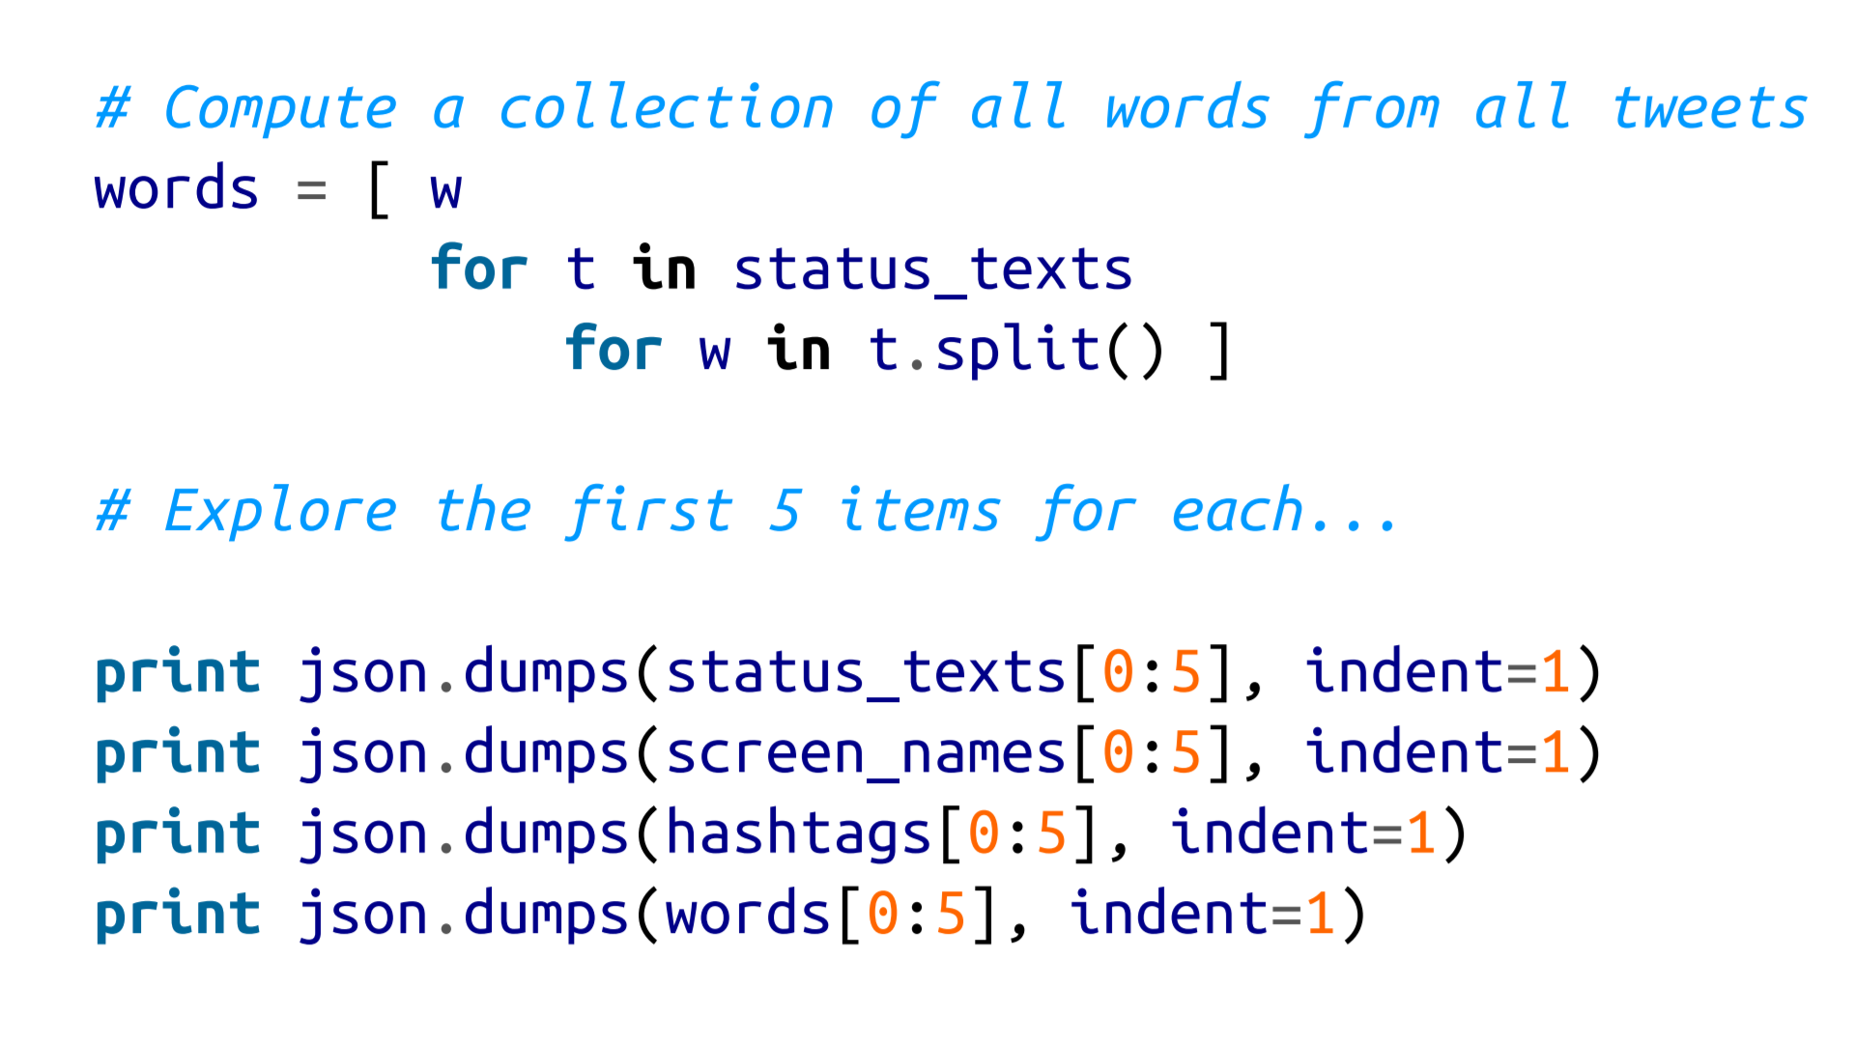
Notes:
Sample output follows; it displays five status texts, screen names, and hashtags to provide a feel for what’s in the data.
<number>

Slide 6
In Python, syntax in which square brackets appear after a list or string value, such as status texts[0:5], is indicative of slicing, whereby you can easily extract items from lists or substrings from strings.
In this particular case, [0:5] indicates that you’d like the first five items in the list status texts (corresponding to items at indices 0 through 4).

Slide 7
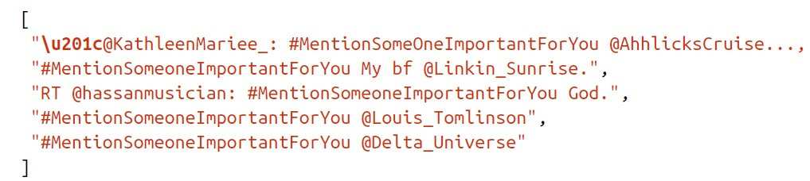

Slide 8
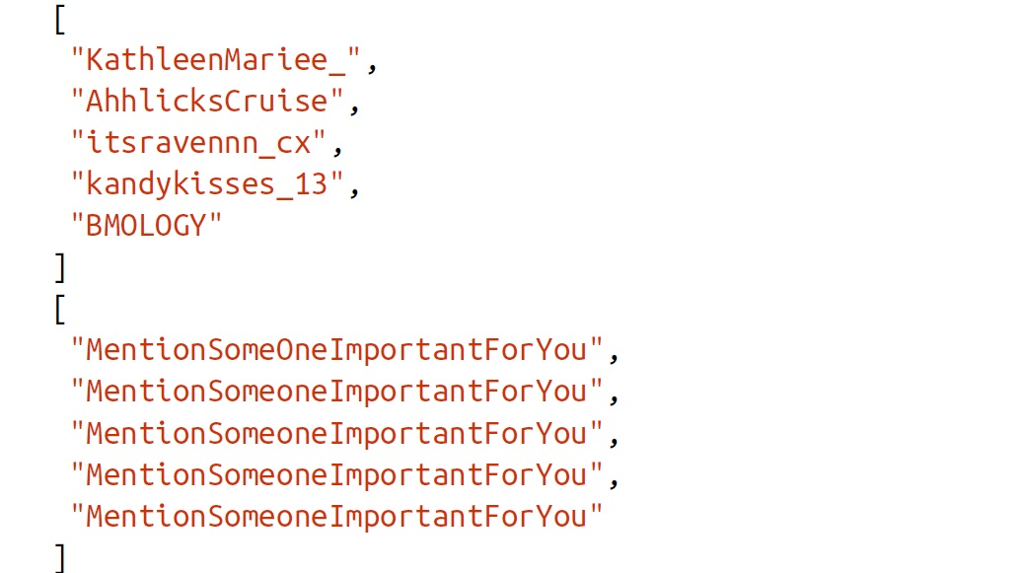

Slide 9
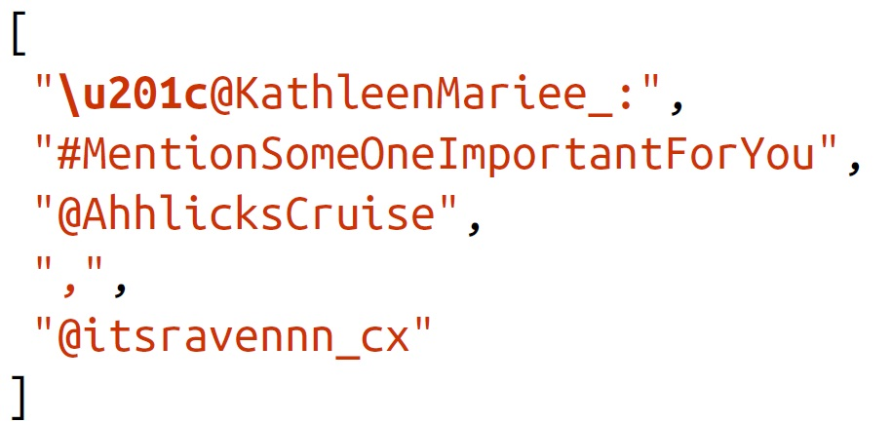
Notes:
As expected, #MentionSomeoneImportantForYou dominates the hashtag output. The output also provides a few commonly occurring screen names that are worth investigating.
<number>

Slide 10
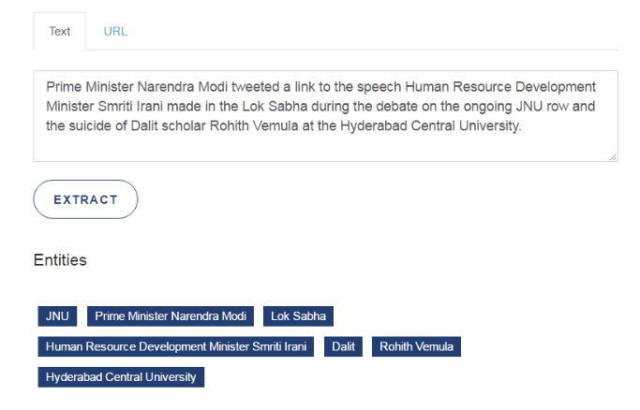
Use Cases of Entity Extraction
Classifying content for news providers.

Slide 11

Analyzing Tweets and Tweet Entities with Frequency Analysis:-
Manipulating data so that it can be counted and further manipulated in meaningful ways.

Slide 12
Let’s now take a closer look at what’s in the data by computing a frequency distribution and looking at the top 10 items in each list.
Among the more compelling reasons for mining Twitter data is to try to answer the question of what people are talking about right now.
One of the simplest techniques you could apply to answer this question is basic frequency analysis, just as we are performing here.
Notes:
<number>

Slide 13
Example 1-7.
Creating a basic frequency distribution from the words in tweets
from collections import Counter
for item in [words, screen_names, hashtags]:
c = Counter(item)
print c.most_common()[:10] #top 10
print

Slide 14
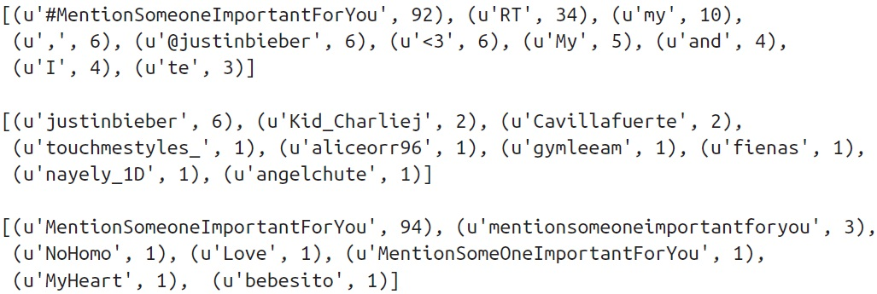
The result of the frequency distribution is a map of key/value pairs corresponding to terms and their frequencies.

